Slide 1




IMpaCT - Data Processing Workshop on Cryo-EM applied to macromolecular complexes: single particle analysis and atomic modelling
ITQB, Lisbon, September 17 – 20, 2019
Roberto Marabini
Marta Martínez

Slide 2
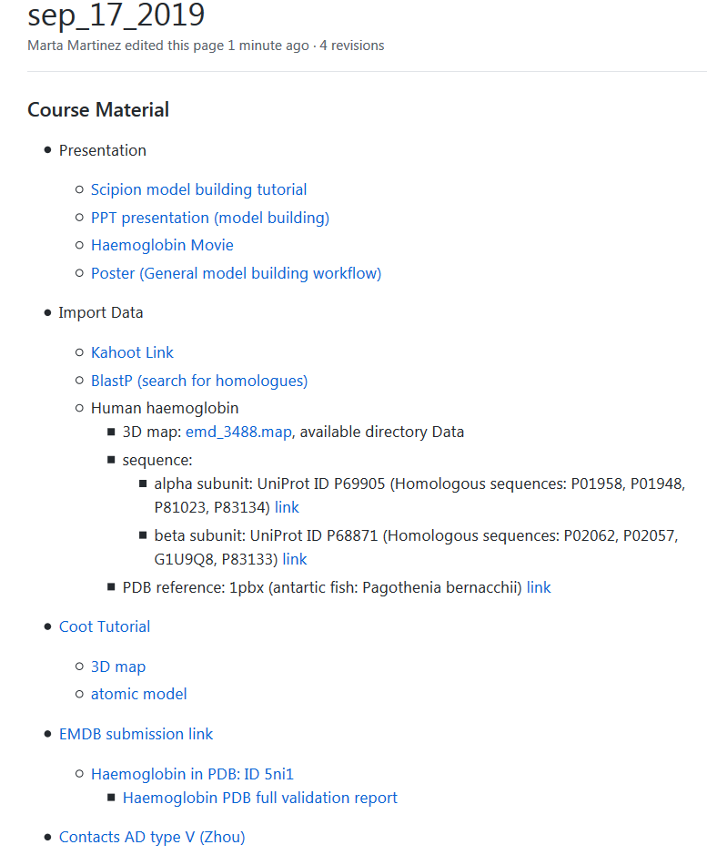
https://github.com/I2PC/scipion-courses/wiki/sep_17_2019

Slide 3
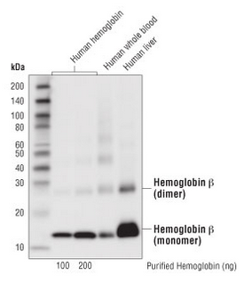
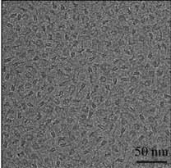
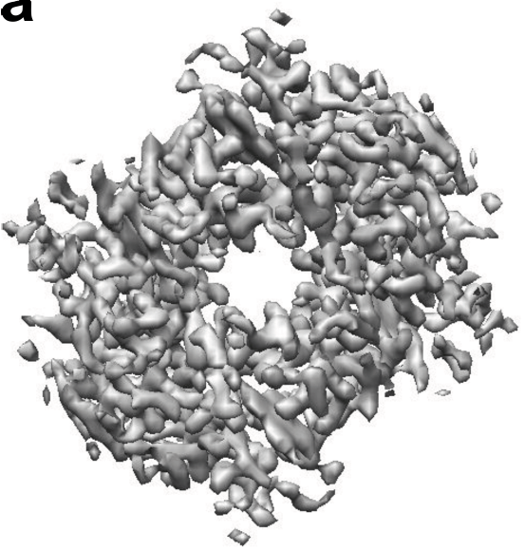
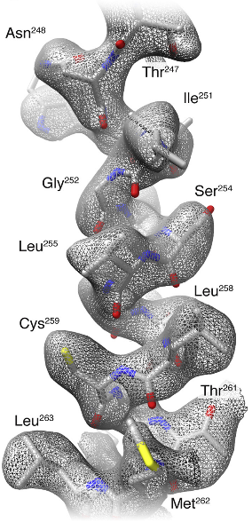
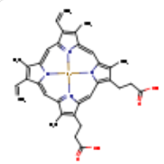
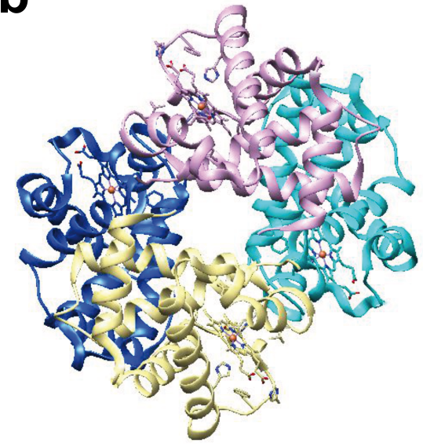
Approach to the problem
Electron density map
Model building
SPA workflow
www.cellsignal.com
2 Hemoglobin subunit α (141 aa)
4 HEME
2 Hemoglobin subunit β (146 aa)
Atomic model
(Khoshouei et al., 2017)

Slide 4
Model building
Basic steps
Tools

Slide 5
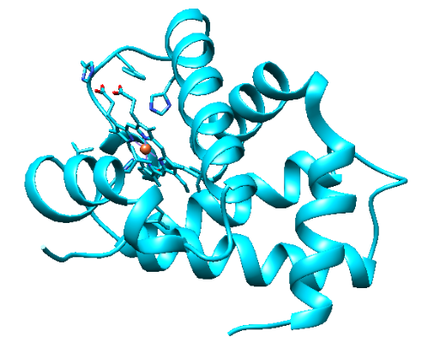
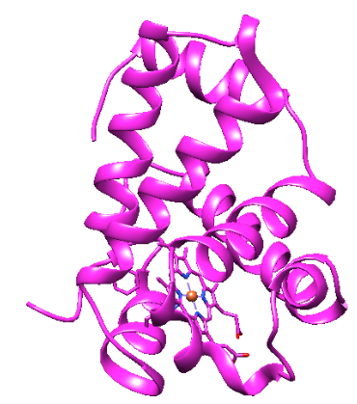
1.- Get the initial model (s)
Homology modeling
Our proteins borrow
the structure
of similar proteins
www.cellsignal.com
2 Hemoglobin subunit α (141 aa)
4 HEME
2 Hemoglobin subunit β (146 aa)
1st clue:
Skeleton of α carbons
and
many side chains

Slide 6
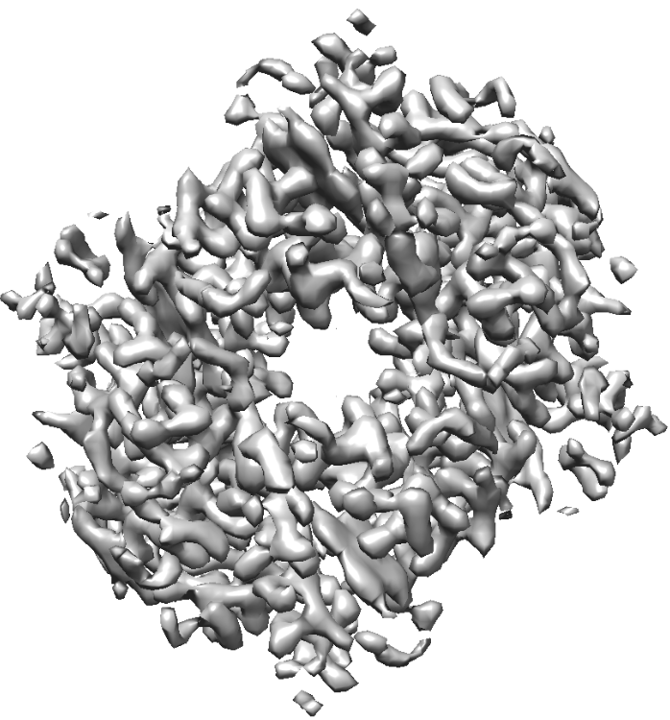
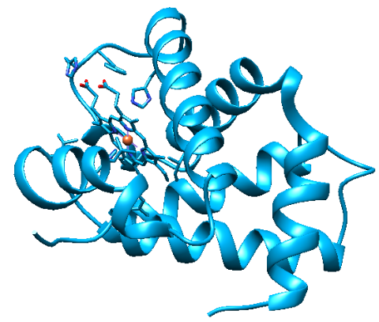
2.- Rigid fitting of model(s) in map

Slide 7
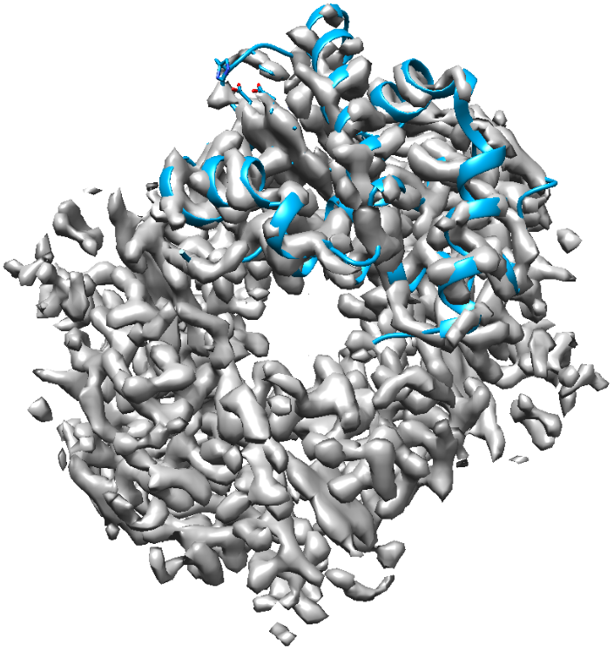
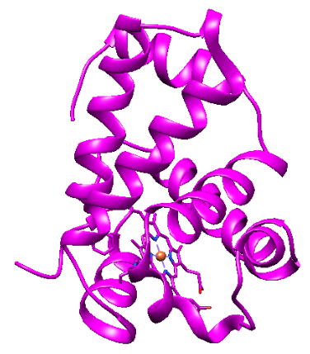
2.- Rigid fitting of model(s) in map

Slide 8
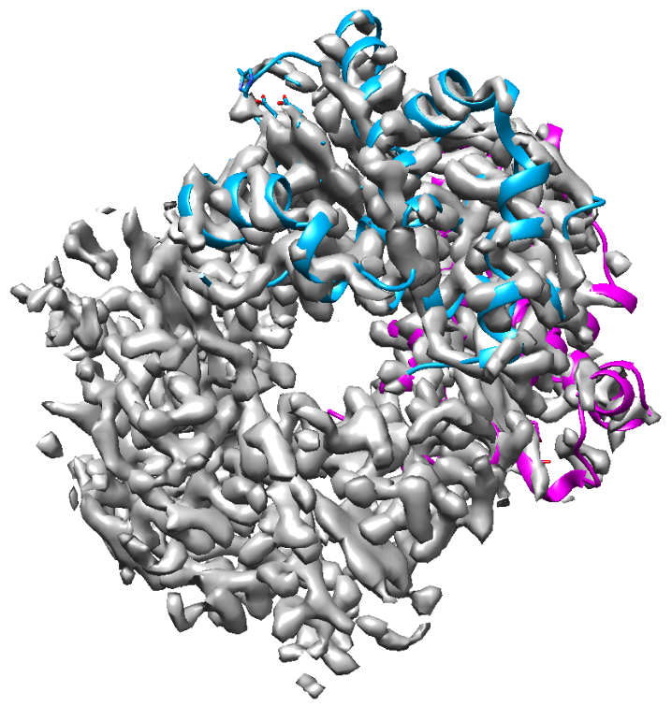
2.- Rigid fitting of model(s) in map

Slide 9
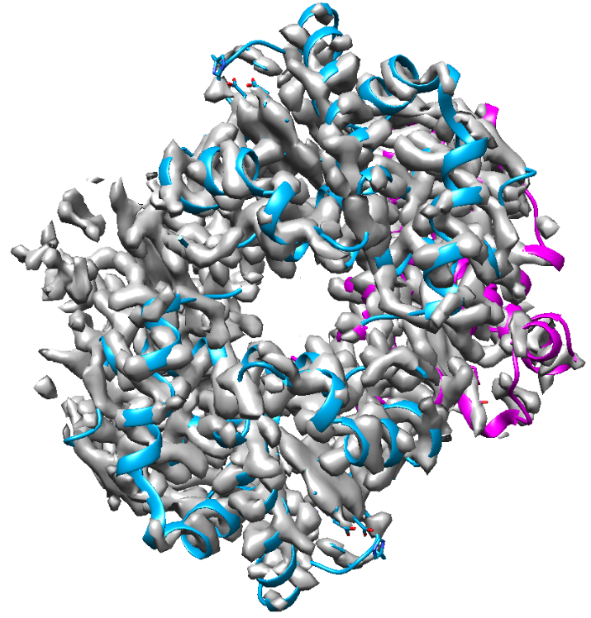
2.- Rigid fitting of model(s) in map

Slide 10
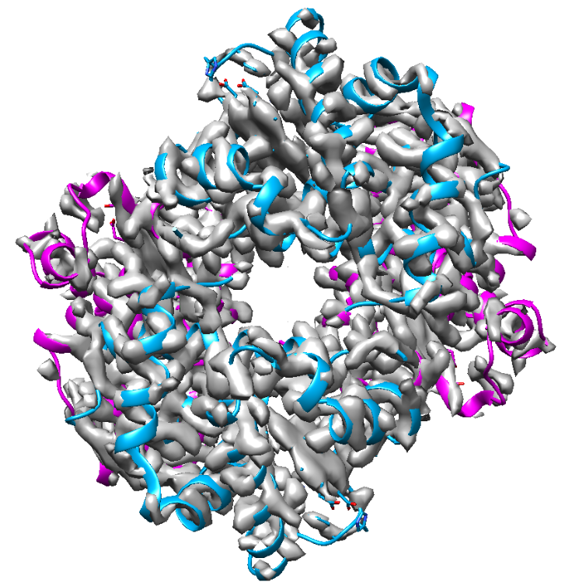
2.- Rigid fitting of model(s) in map

Slide 11
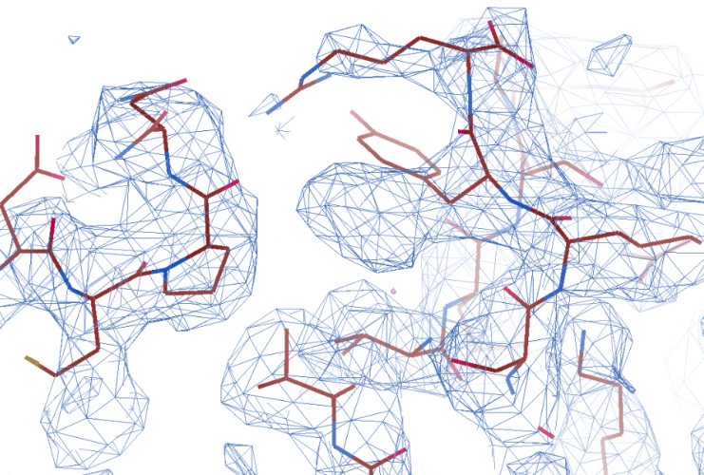
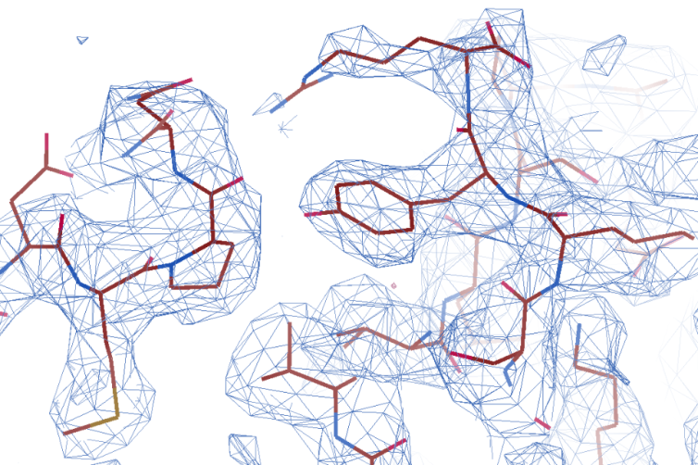
3.- Flexible fitting (refinement) of model(s) in map
Get the final model(s)
Manual and automatic

Slide 12
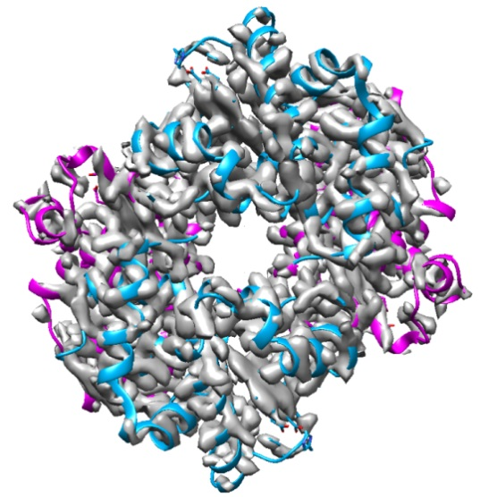
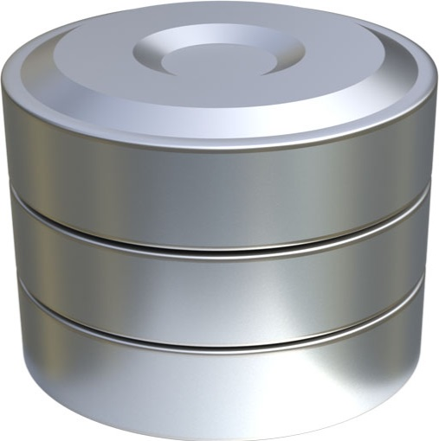

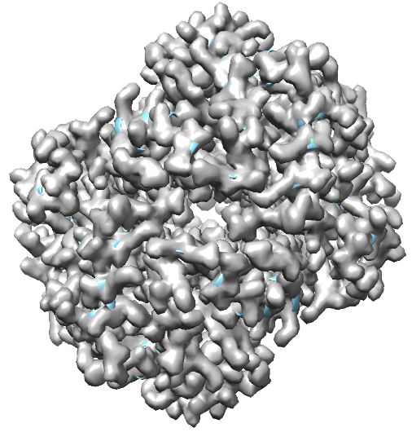

4.- Model(s) validation
Is this structure reliable?
Map and model similarity
Geometry
Map/model
fitting
PDB
Is this structure similar
to structures of the database?
(Bond lengths, angles, contacts …)
Is the map derived from the model similar to the original map?
Q (Submission)

Slide 13
the problem
Model building
Basic steps
0.- Map preprocessing
1.- Get the initial model (s)
2.- Rigid fitting of model(s) in map
3.- Flexible fitting (refinement)
of model(s) in map
4.- Model(s) validation
Tools

Slide 14
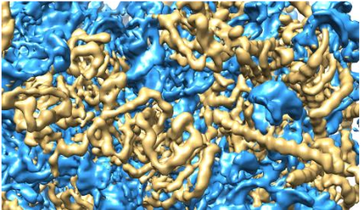
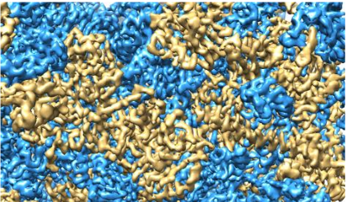
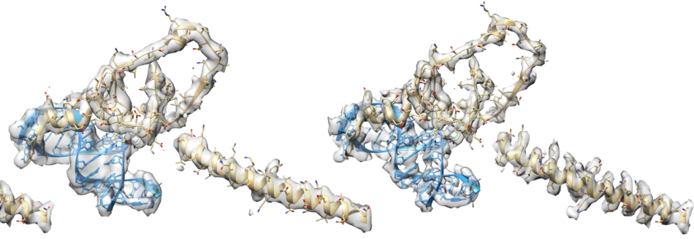
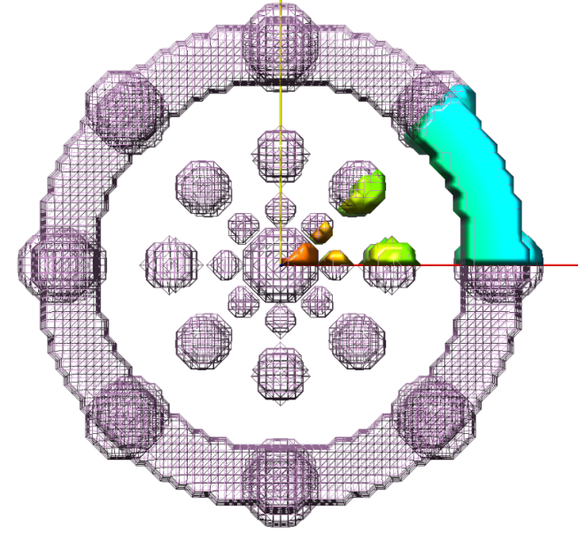
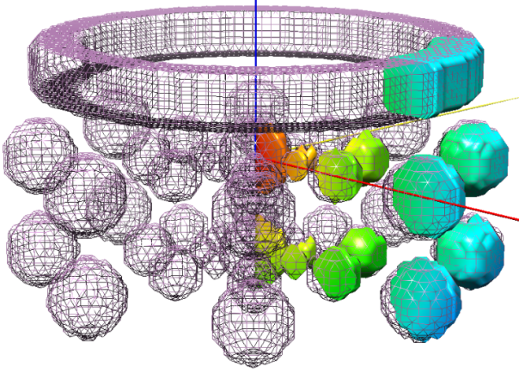
0.- Map preprocessing
Map sharpening
Ramírez-Aportela et al., 2018
Extract unit cell
sym C8

Slide 15
the problem
Model building
Basic steps
0.- Map preprocessing
1.- Get the initial model (s)
2.- Rigid fitting of model(s) in map
3.- Flexible fitting (refinement)
of model(s) in map
4.- Model(s) validation
Tools

Slide 16
the problem
Model building
Basic steps
0.- Map preprocessing
1.- Get the initial model (s)
2.- Rigid fitting of model(s) in map
3.- Flexible fitting (refinement)
of model(s) in map
4.- Model(s) validation
Tools

Slide 17
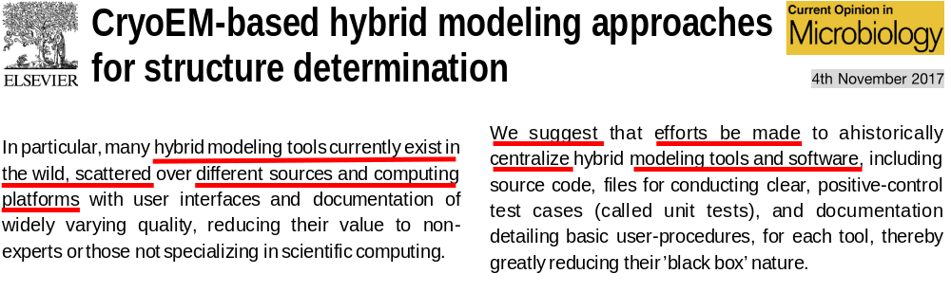

Tools
* Borrowed from crystallography
* Specifically designed for cryo-EM data
(Cassidy et al.)

Slide 18
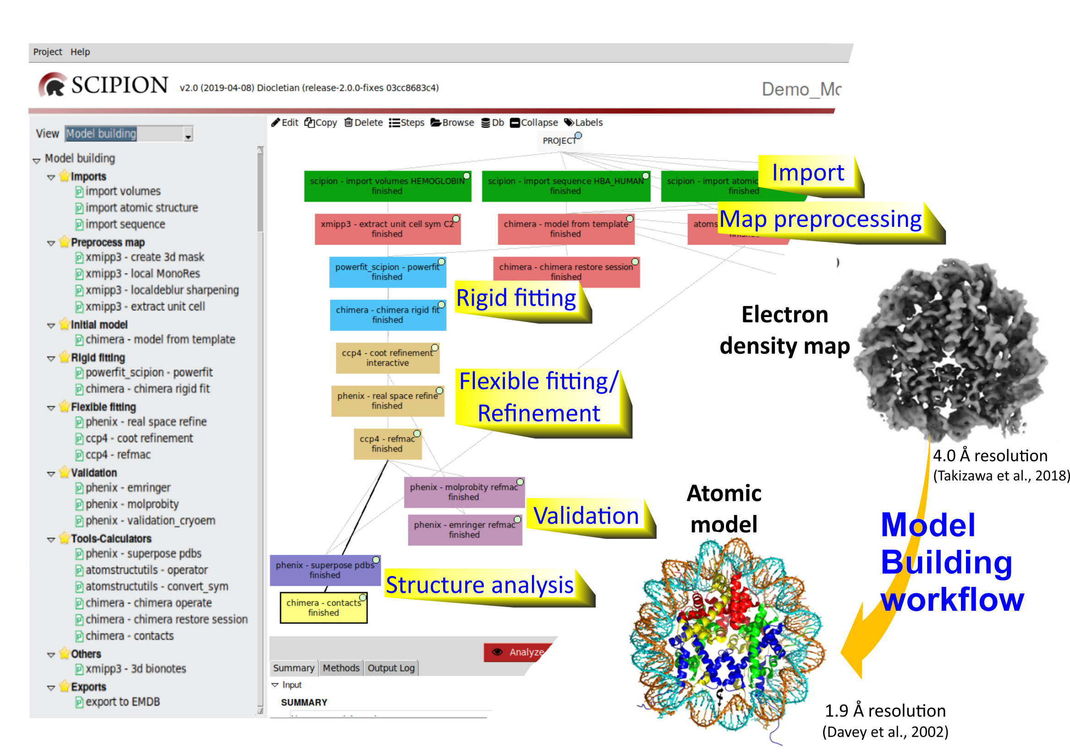

Slide 19
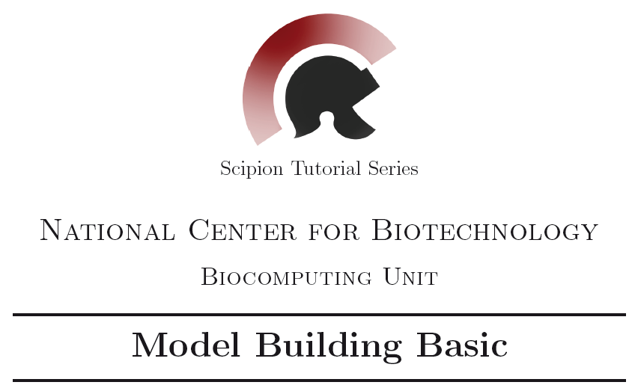
https://github.com/I2PC/scipion/wiki/tutorials/tutorial_model_building_basic.pdf

Slide 20
Human Haemoglobin
subunit α (141 aa)
subunit β (146 aa)
subunit β (146 aa)
subunit α (141 aa)
sym C2; 3.2 Å resolution
(Khoshouei et al., 2017)

Slide 21
Human Haemoglobin
subunit α (141 aa)
subunit β (146 aa)
subunit β (146 aa)
subunit α (141 aa)
sym C2; 3.2 Å resolution
(Khoshouei et al., 2017)

Slide 22

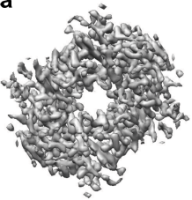





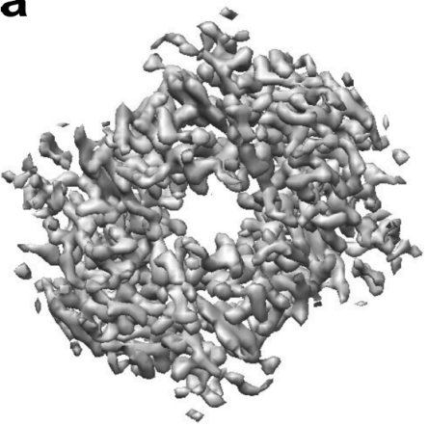


Import
Hgb map
αHgb seq
Create 3D mask
Search for
homologous sequences
PDB
Local resolution
Import
Other seqs
1pbx
Preprocessing
Local deblur
Hgb sharpened map
Initial
model
αHgb seq
α1pbx seq
Sym C2
Other seqs
MODELING WORKFLOW IN SCIPION
Extract unit cell
Powerfit
Rigid fitting
Chimera rigid fit

Slide 23



Powerfit
Rigid fitting
Chimera rigid fit
phenix - emringer
phenix - molprobity
Validation
CCP4 Coot
phenix – validation cryoEM
MODELING WORKFLOW IN SCIPION
Flexible fitting
Phenix – real space refine
CCP4 refmac
phenix - emringer
Export to EMDB
phenix - emringer
Export to EMDB
Validation
phenix - molprobity
phenix - molprobity
phenix – validation cryoEM
phenix – validation cryoEM

Slide 25


Slide 26
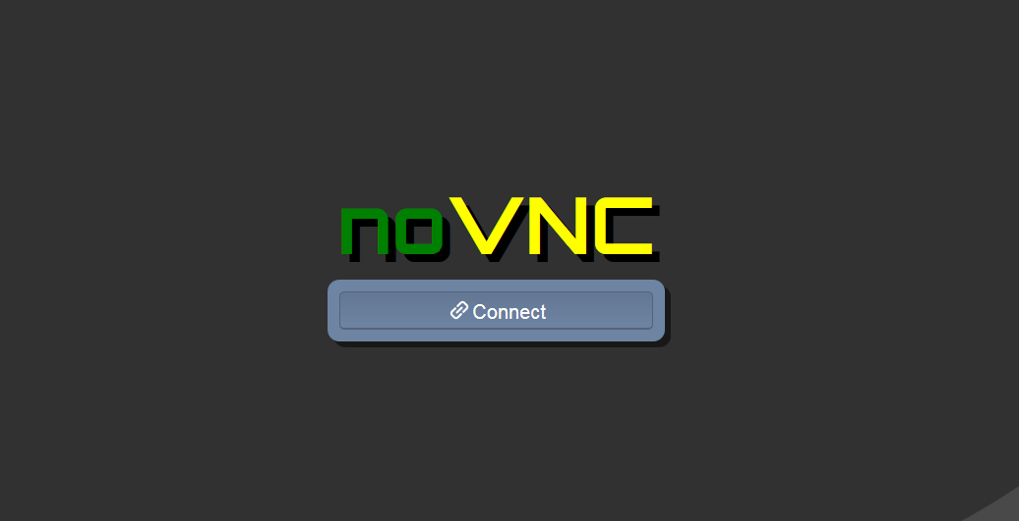
password: scipion4u

Slide 27
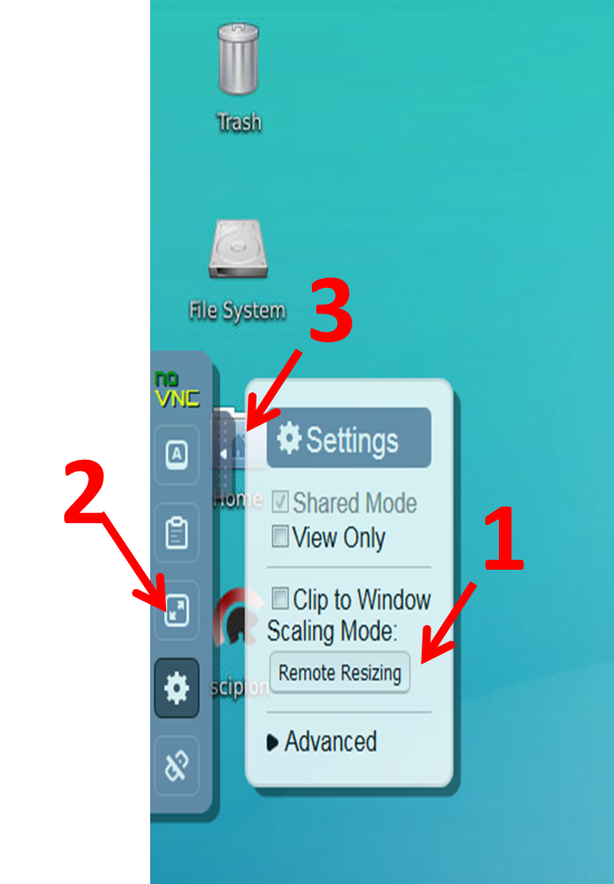

Slide 28
AGDEFE
AGDEFE
Human (target)
Human (target)
AGEEFE
EFEEFE
Fish (template)
Fish (template)
AGDEFE
Human (target)
EFEEFE
Fish (template)
E
D
G
G
E
E
AGDEFE
A
A
Human (target)
F
F
AFDEFE
E
Mammal
E
AGEEFE
Bird
EGEEFE
Fish (template)
Human (target)
Reptile
EFEEFE
Fish (template)

Slide 29
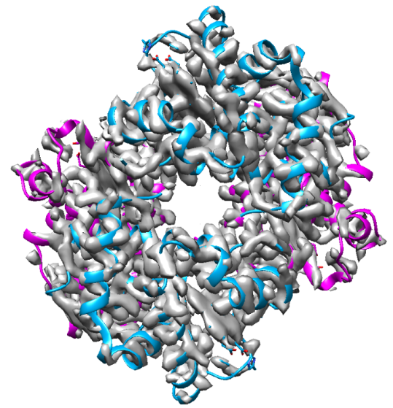

4.- Model(s) validation
Is this structure reliable?
Map and model similarity
Geometry
Map/model
fitting
PDB
Is this structure similar
to structures of the database?
(Bond lengths, angles, contacts …)
Is the map derived from the model similar to the original map?
Q (Submission)

Slide 30
4.- Model(s) validation
Is this structure reliable?
Map and model similarity
Geometry
Map/model
fitting
EMRinger
(high resolution)
PDB
Is this structure similar
to structures of the database?
(Bond lengths, angles, contacts …)
CC
FSC
(low resolution)
MolProbity
Is the map derived from the model similar to the original map?

Slide 31
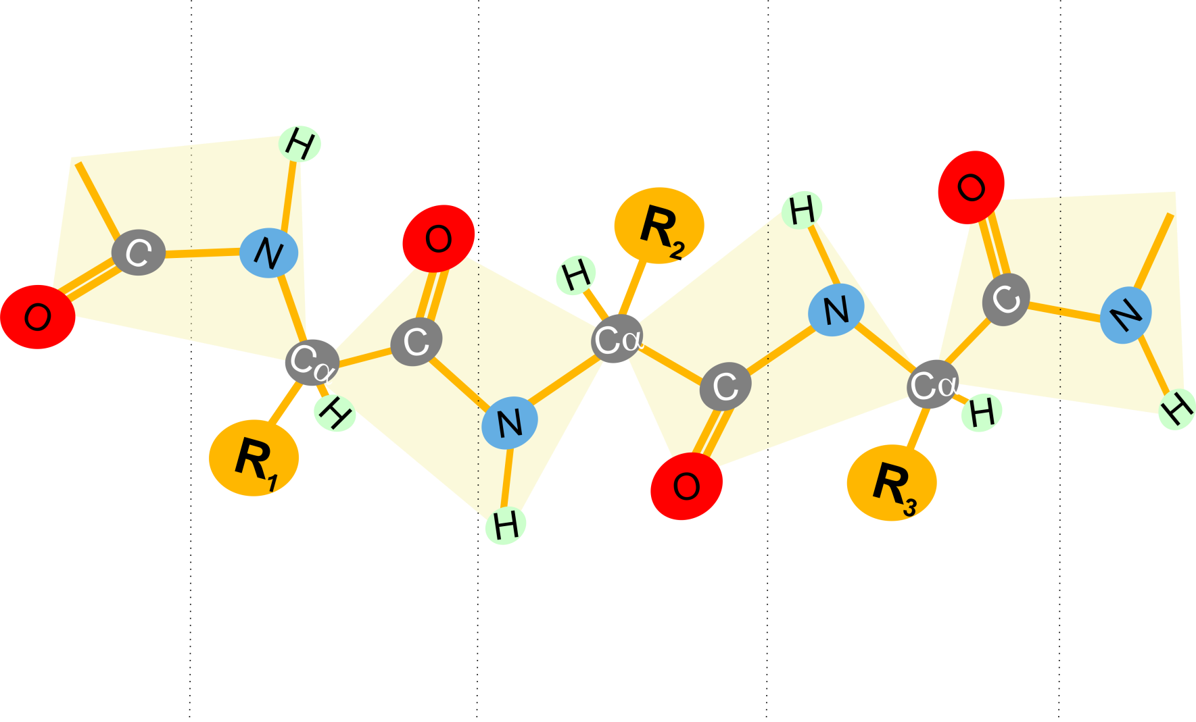
Geometry
MolProbity
Skeleton of Cα

Slide 32
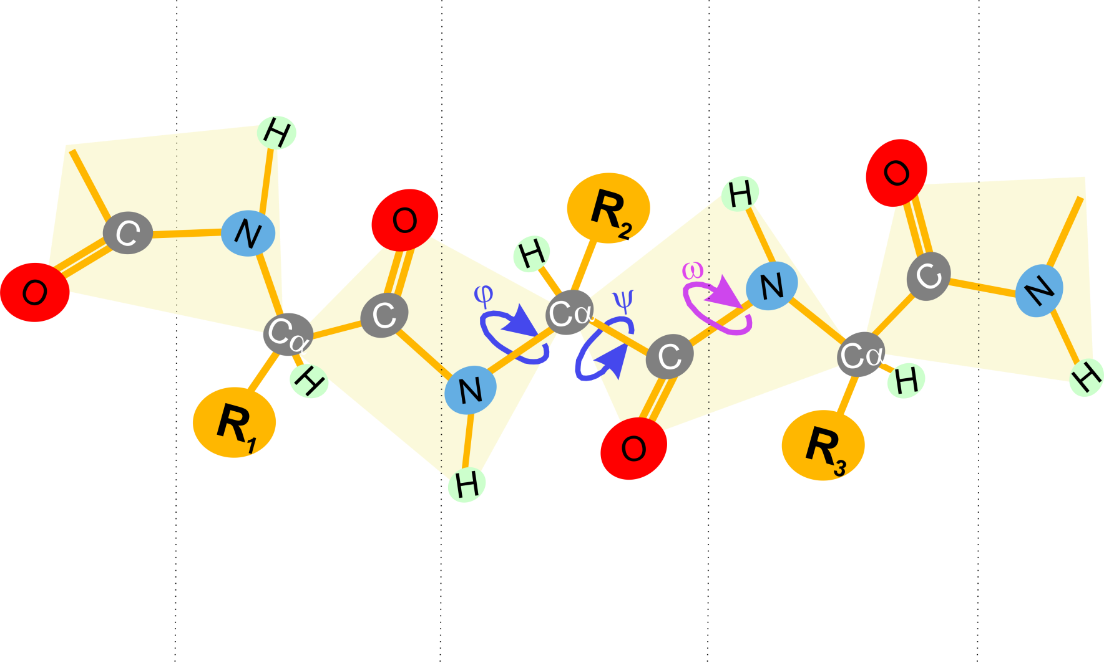
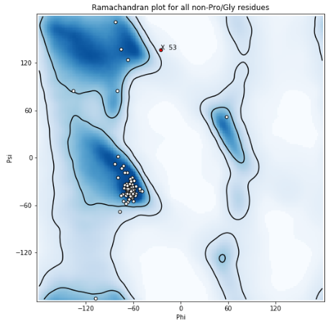
Geometry
MolProbity
Favored
Skeleton of Cα
Allowed
Outliers
Side chains

Slide 33
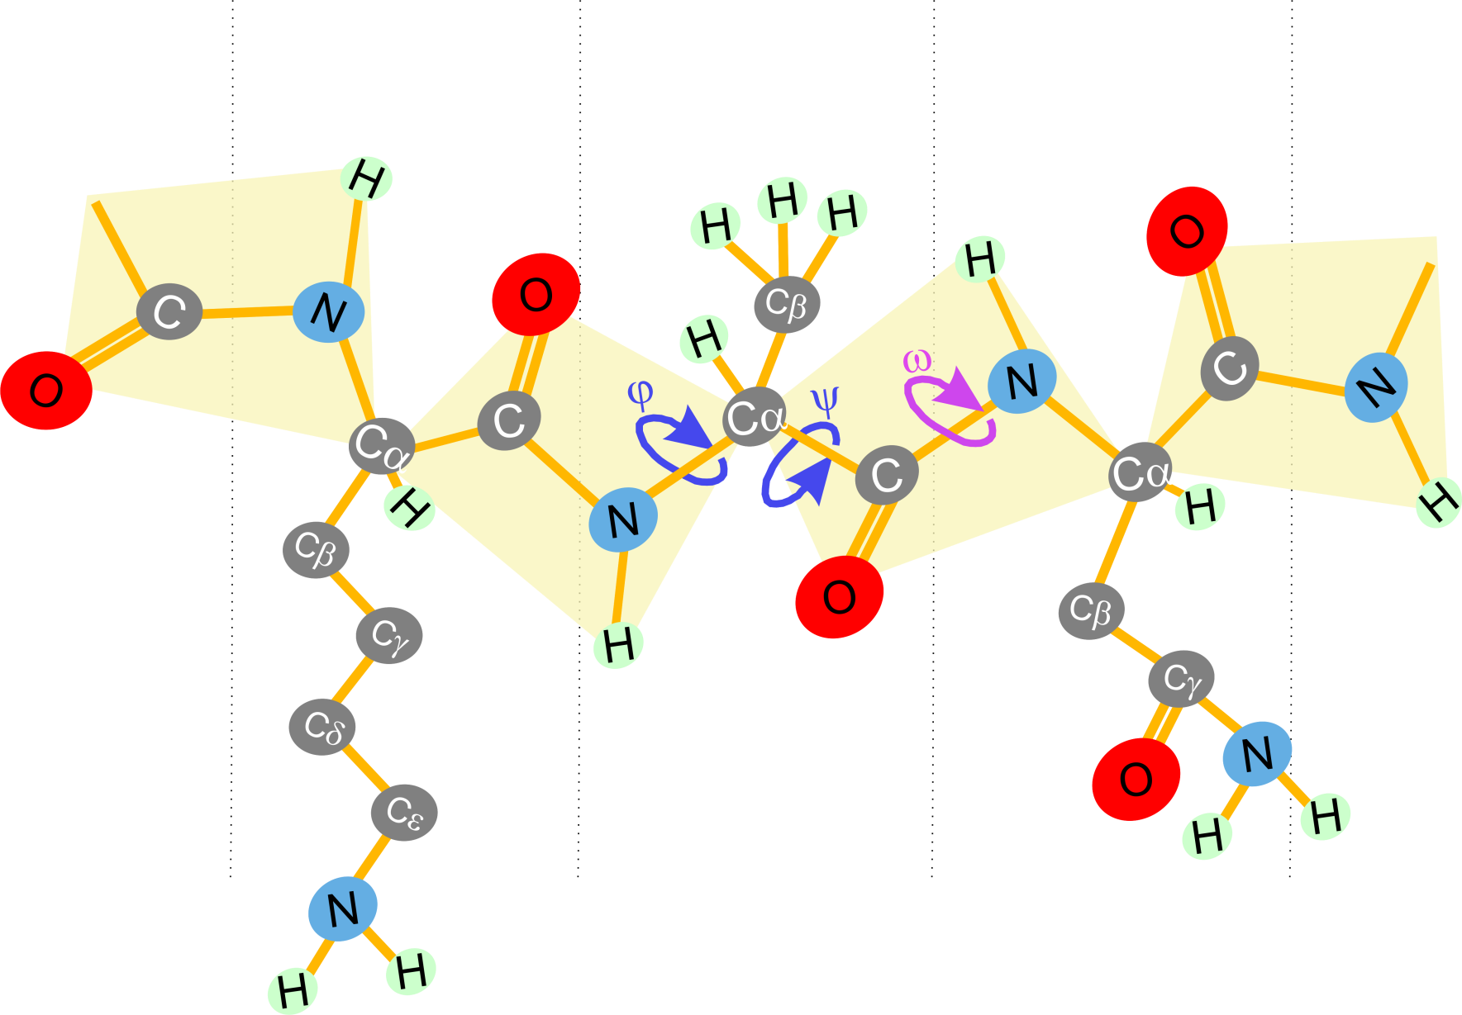
Geometry
MolProbity
Lys
Ala
Asn
Side chains

Slide 34
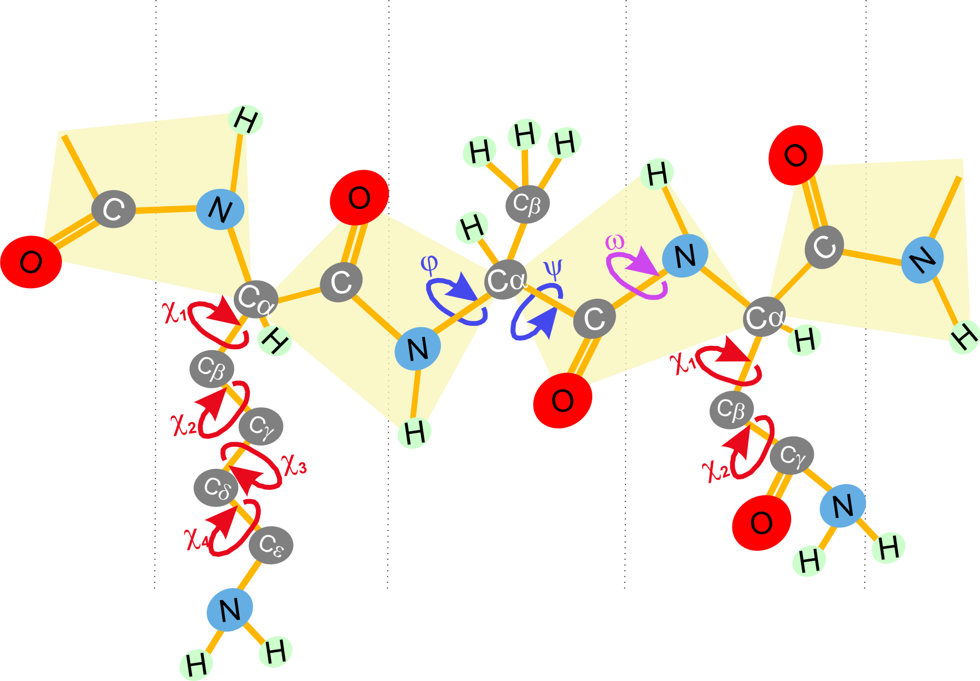
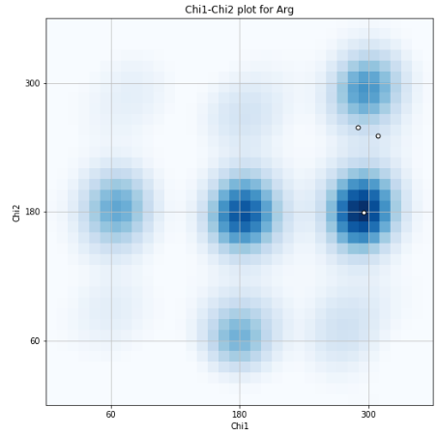
Geometry
MolProbity
Lys
Ala
Asn
Side chains
Rotamer Outliers
C_{β}

Slide 35
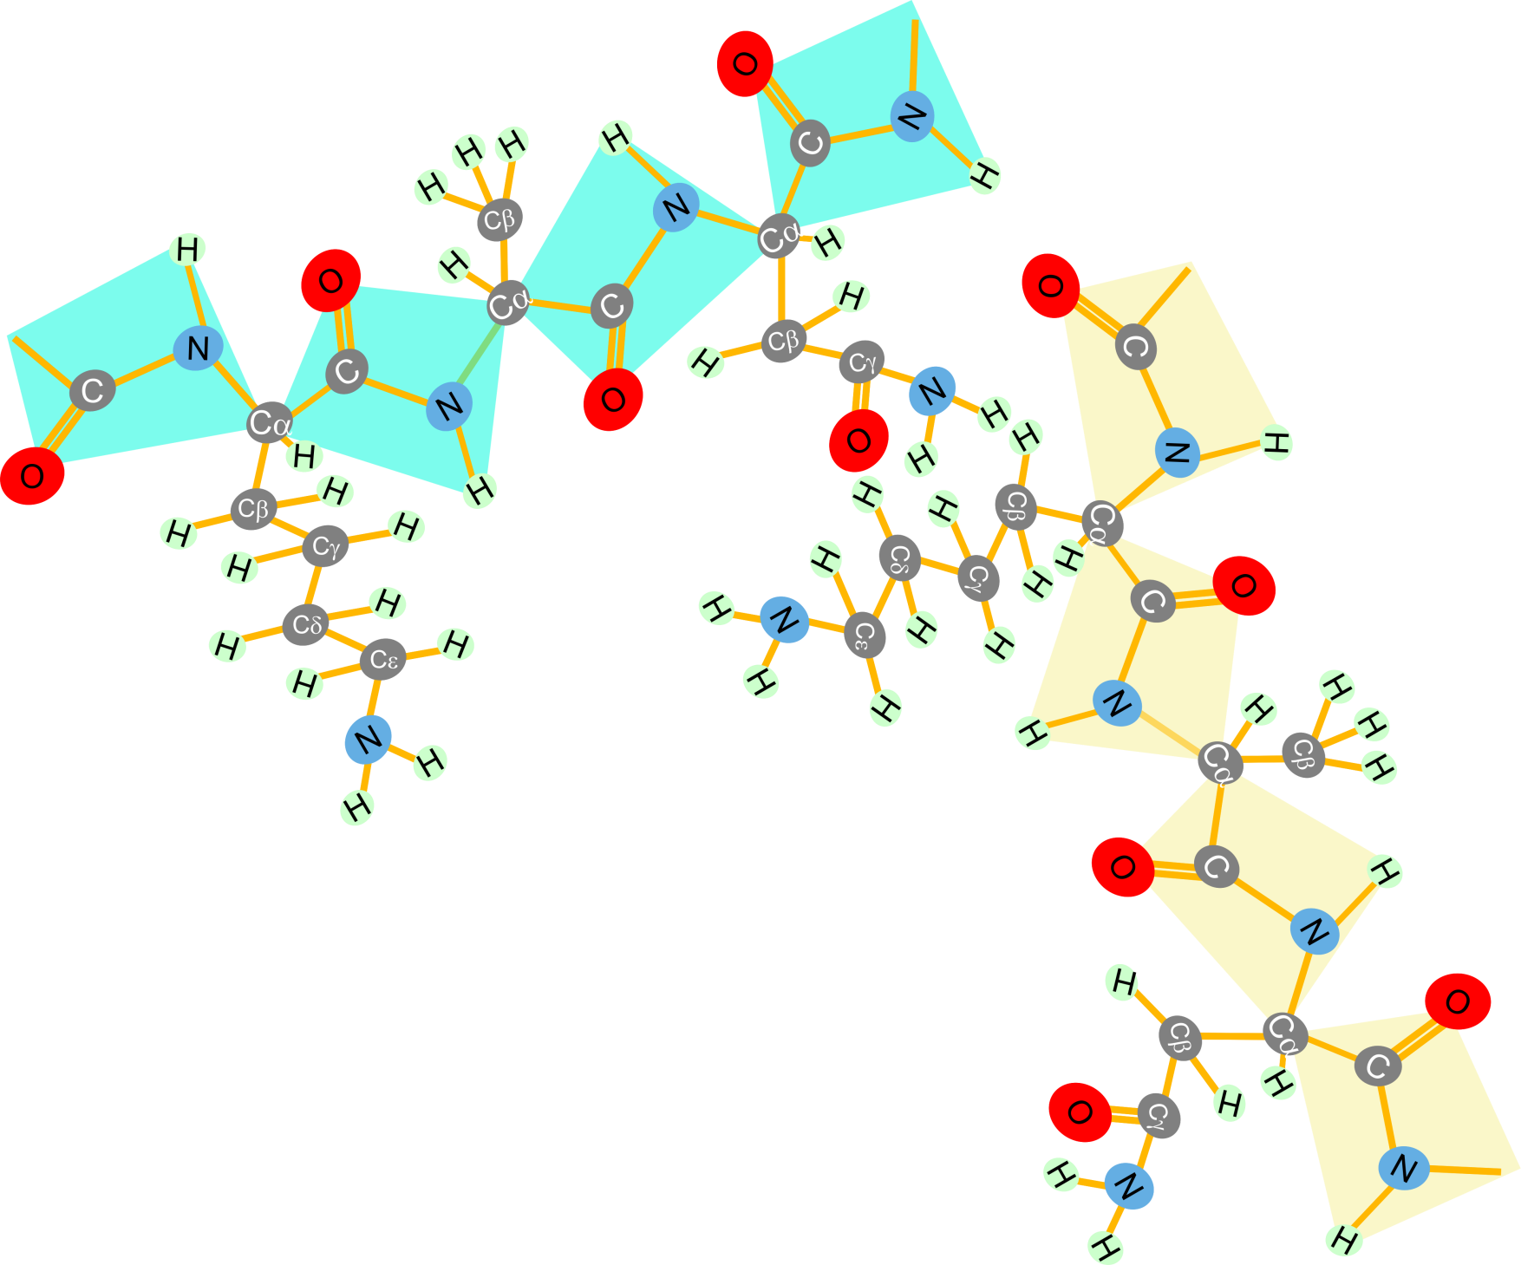
Geometry
MolProbity
Clashscore
Atom clashes
Overall score

Slide 36
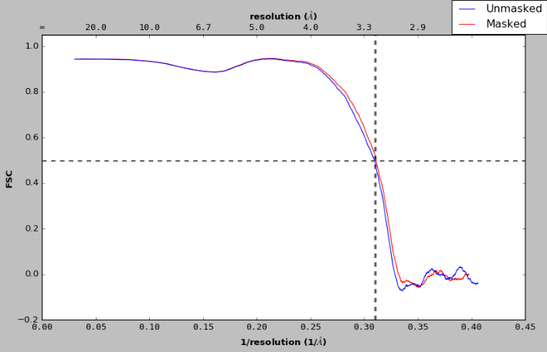


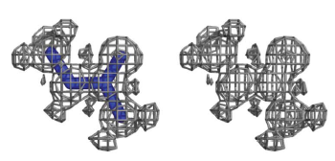
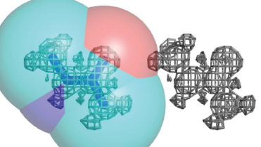
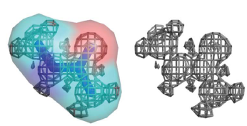
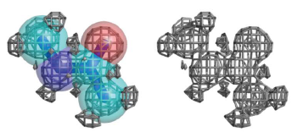
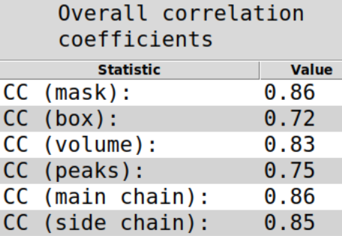
Map and model similarity
CC
FSC
FSC
“how well does the atomic model reproduce the whole set of experimental data?”
“how well does the available atomic model describe the part of the map around atomic centers?”
Correlation
CC (mask)
CC (box)

Slide 37

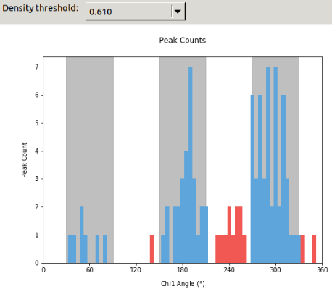
Map and model similarity
EMRinger
Rotameric
Non Rotameric
Side chains

Slide 38

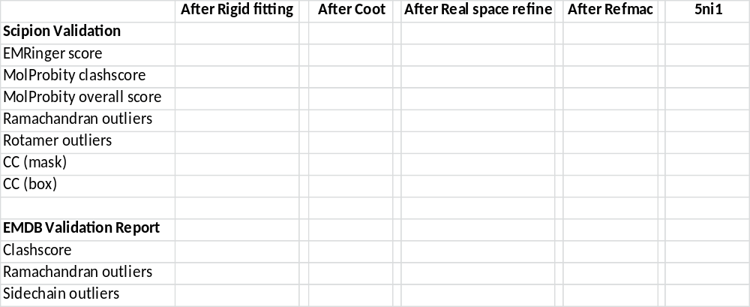
3.97
3.53
1.48
0
0.43 %
0.87
0.74
3
0
0.4 %

