Slide 1




Instruct course on Image Processing for Electron Microscopy and hybrid modelling
Madrid, July 8 – 11, 2019
Roberto Marabini
Marta Martínez

Slide 2
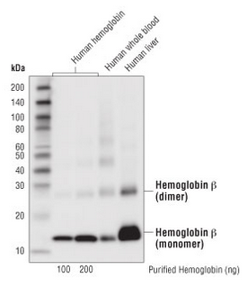
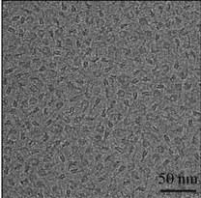
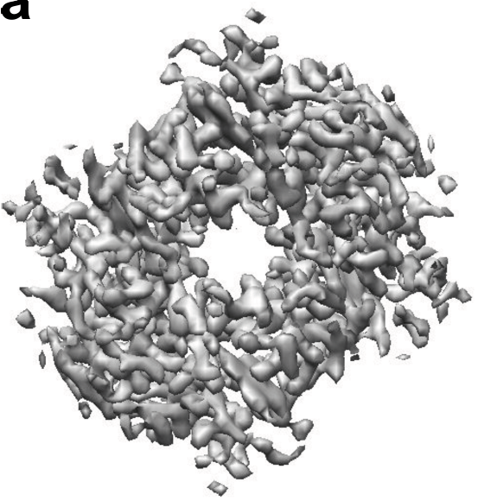
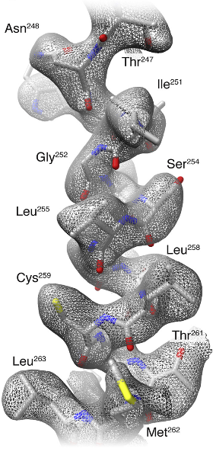
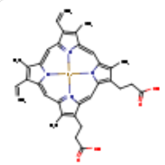
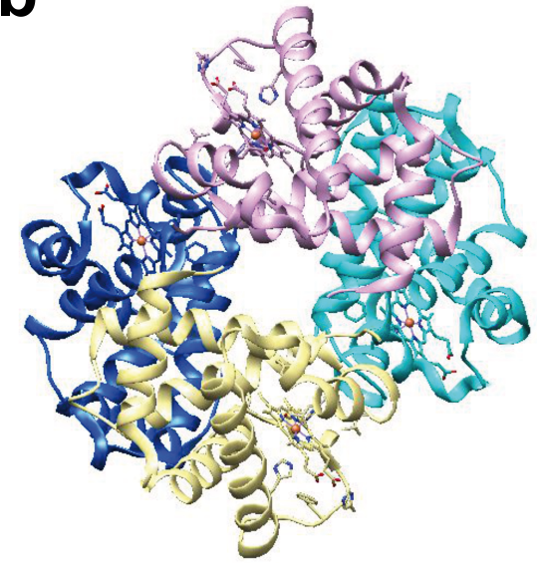
Approach to the problem
Electron density map
Model building
SPA workflow
www.cellsignal.com
2 Hemoglobin subunit α (141 aa)
4 HEME
2 Hemoglobin subunit β (146 aa)
Atomic model
(Khoshouei et al., 2017)

Slide 3
Model building
Basic steps
Tools

Slide 4
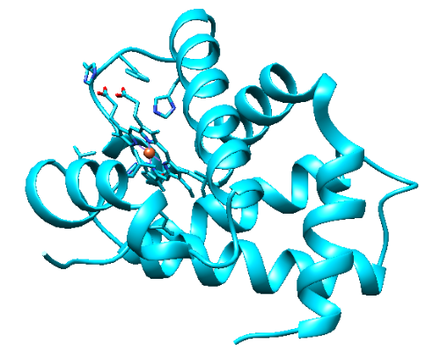
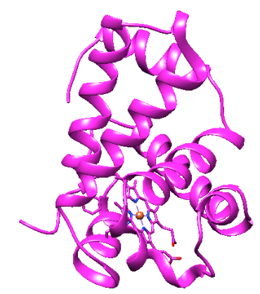
1.- Get the initial model (s)
Homology modeling
Our proteins borrow
the structure
of similar proteins
www.cellsignal.com
2 Hemoglobin subunit α (141 aa)
4 HEME
2 Hemoglobin subunit β (146 aa)
1st clue:
Skeleton of α carbons
and
many side chains

Slide 5
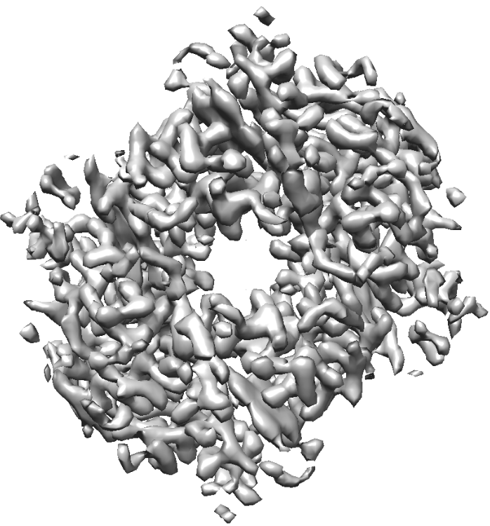
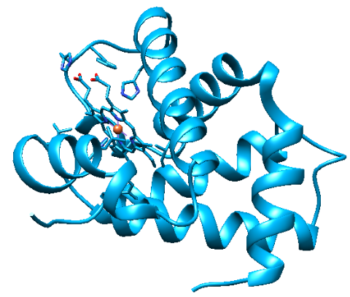
2.- Rigid fitting of model(s) in map

Slide 6
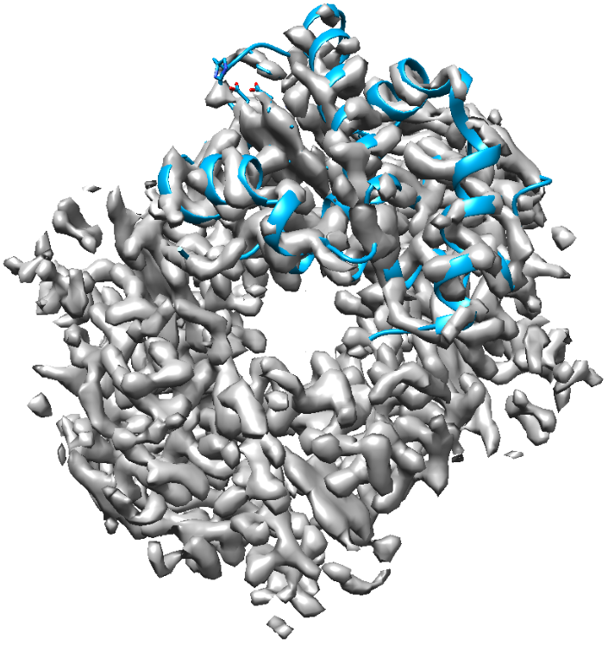
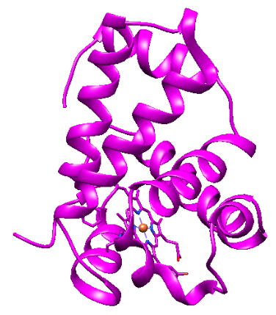
2.- Rigid fitting of model(s) in map

Slide 7
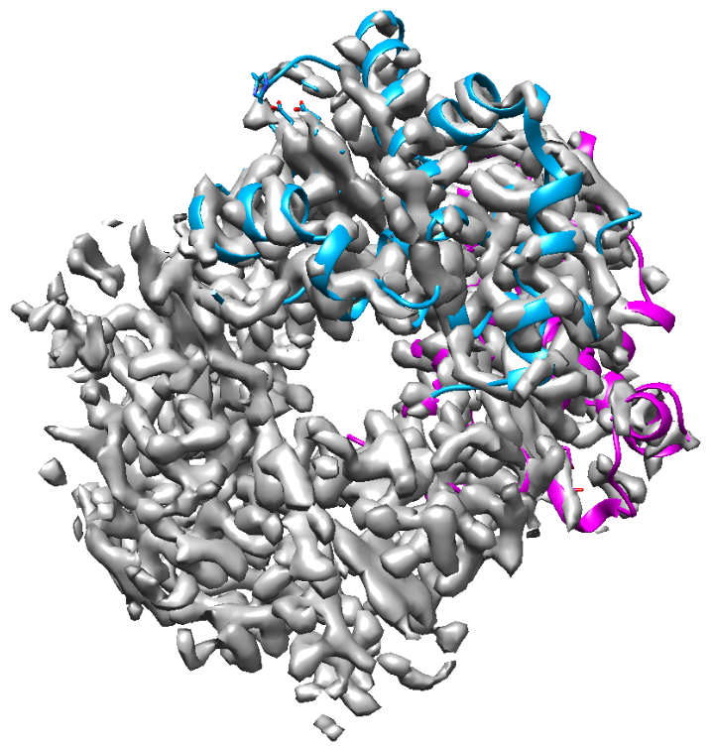
2.- Rigid fitting of model(s) in map

Slide 8
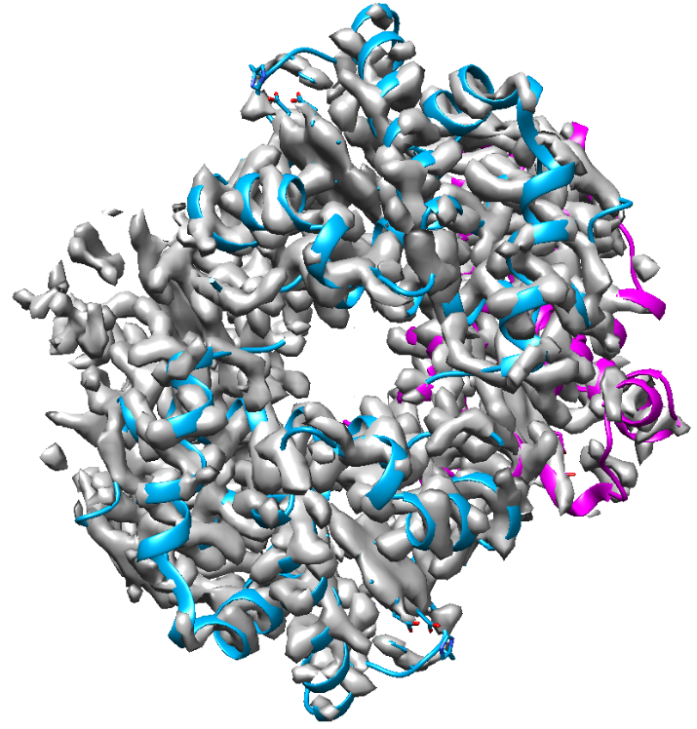
2.- Rigid fitting of model(s) in map

Slide 9
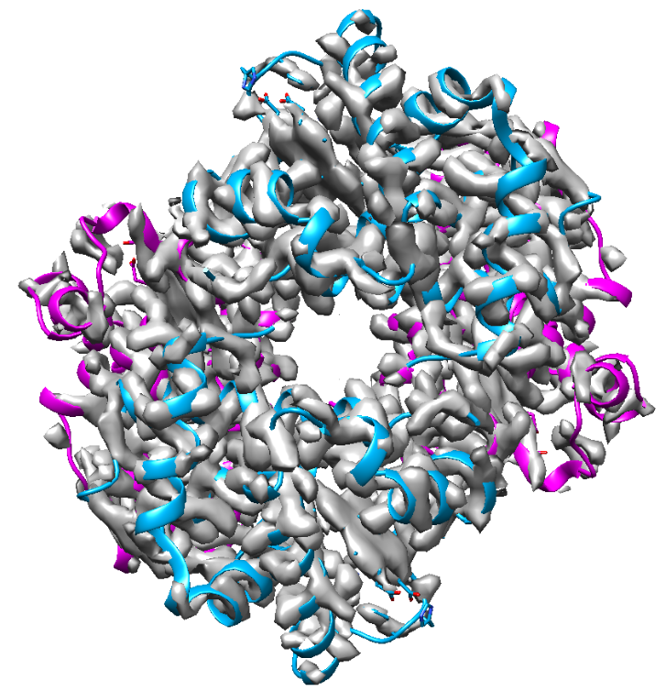
2.- Rigid fitting of model(s) in map

Slide 10
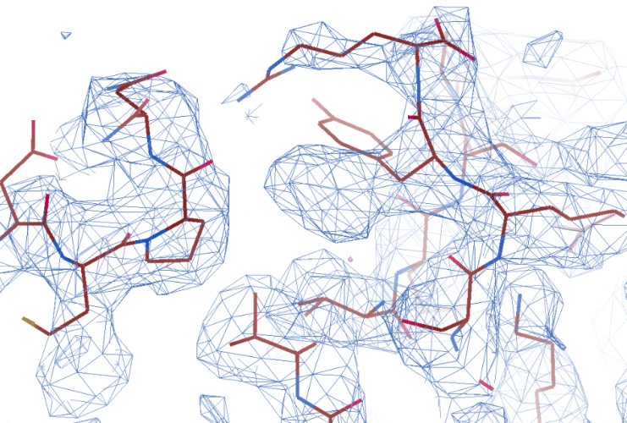
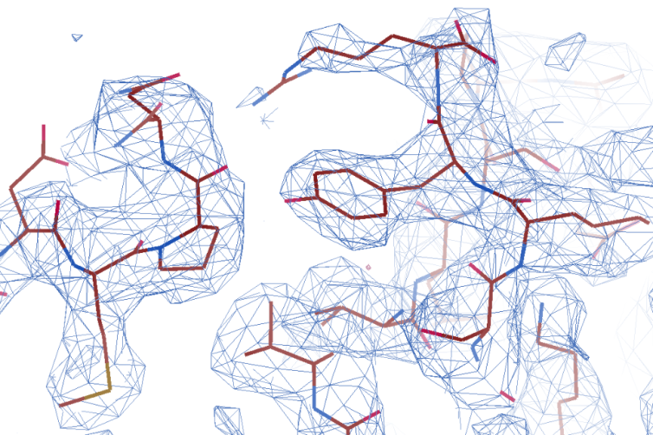
3.- Flexible fitting (refinement) of model(s) in map
Get the final model(s)
Manual and automatic

Slide 11
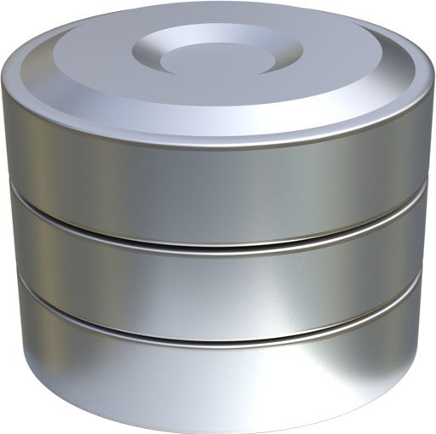


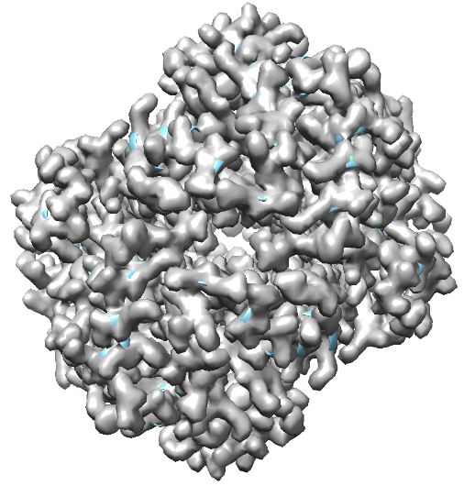
4.- Model(s) validation
Is this structure reliable?
Map and model
similarity
Geometry
PDB
Is this structure similar
to structures of the database?
(Bond lengths, angles, contacts …)
Is the map derived from
the model similar to the
original map?
Q (Submission)

Slide 12
the problem
Model building
Basic steps
0.- Map preprocessing
1.- Get the initial model (s)
2.- Rigid fitting of model(s) in map
3.- Flexible fitting (refinement)
of model(s) in map
4.- Model(s) validation
Tools

Slide 13
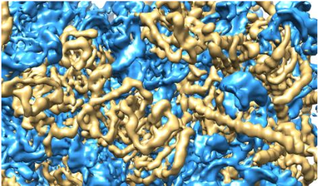
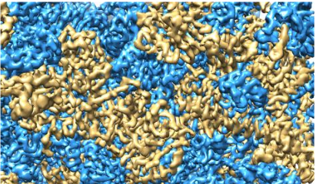
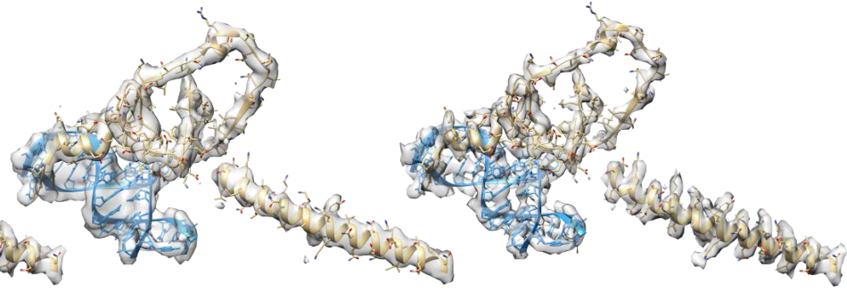
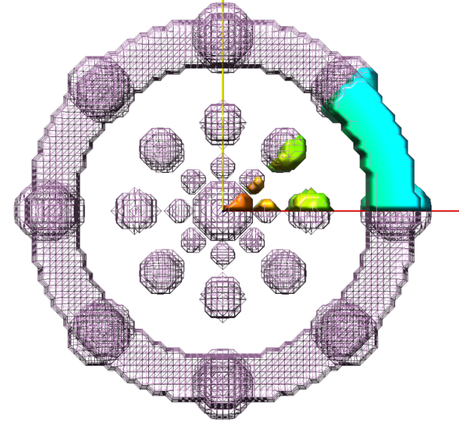
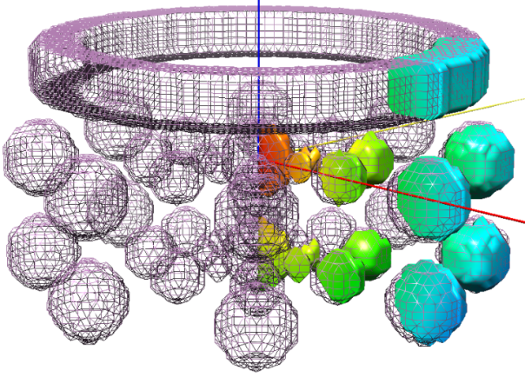
0.- Map preprocessing
Map sharpening
Ramírez-Aportela et al., 2018
Extract unit cell
sym C8

Slide 14
the problem
Model building
Basic steps
0.- Map preprocessing
1.- Get the initial model (s)
2.- Rigid fitting of model(s) in map
3.- Flexible fitting (refinement)
of model(s) in map
4.- Model(s) validation
Tools

Slide 15
the problem
Model building
Basic steps
0.- Map preprocessing
1.- Get the initial model (s)
2.- Rigid fitting of model(s) in map
3.- Flexible fitting (refinement)
of model(s) in map
4.- Model(s) validation
Tools

Slide 16
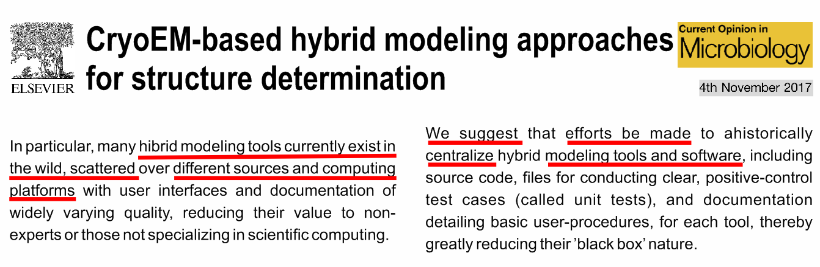

Tools
* Borrowed from crystallography
* Specifically designed for cryo-EM data
(Cassidy et al.)

Slide 17
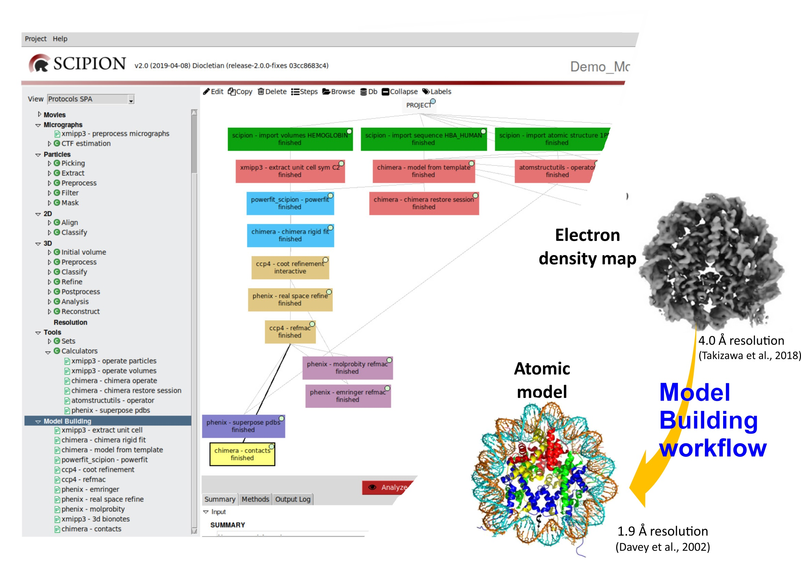

Slide 18
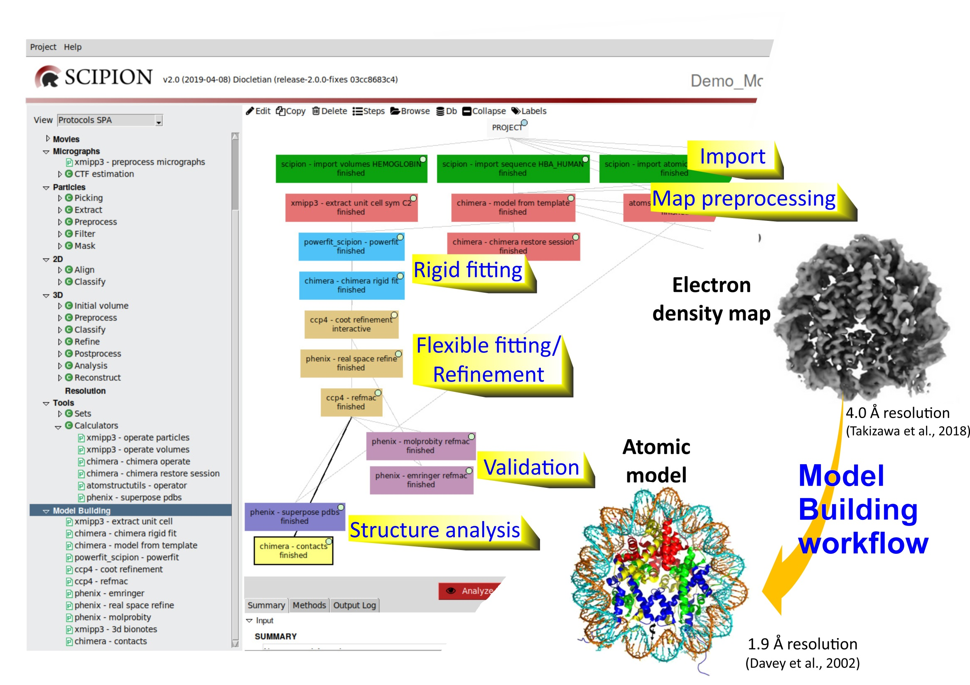

Slide 19
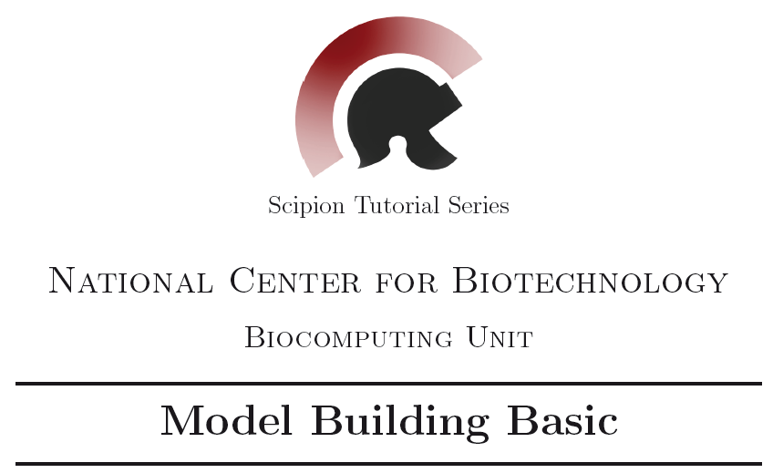
https://github.com/I2PC/scipion/wiki/tutorials/tutorial_model_building_basic.pdf

Slide 20
Human Haemoglobin
subunit α (141 aa)
subunit β (146 aa)
subunit β (146 aa)
subunit α (141 aa)
sym C2; 3.2 Å resolution
(Khoshouei et al., 2017)

Slide 21
Human Haemoglobin
subunit α (141 aa)
subunit β (146 aa)
subunit β (146 aa)
subunit α (141 aa)
sym C2; 3.2 Å resolution
(Khoshouei et al., 2017)

Slide 22

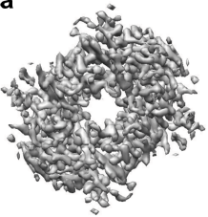





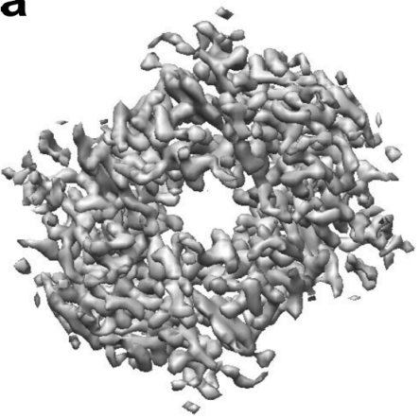


Import
Hgb map
αHgb seq
Create 3D mask
Search for
homologous sequences
PDB
Local resolution
Import
Other seqs
1pbx
Preprocessing
Local deblur
Hgb sharpened map
Initial
model
αHgb seq
α1pbx seq
Sym C2
Other seqs
MODELING WORKFLOW IN SCIPION
Extract unit cell
Powerfit
Rigid fitting
Chimera rigid fit

Slide 23



Powerfit
Rigid fitting
phenix - emringer
Chimera rigid fit
phenix - molprobity
Validation
MODELING WORKFLOW IN SCIPION
CCP4 Coot
Export to EMDB
Flexible fitting
Phenix – real space refine
CCP4 refmac
phenix - emringer
phenix - emringer
Export to EMDB
Export to EMDB
Validation
phenix - molprobity
phenix - molprobity

Slide 24

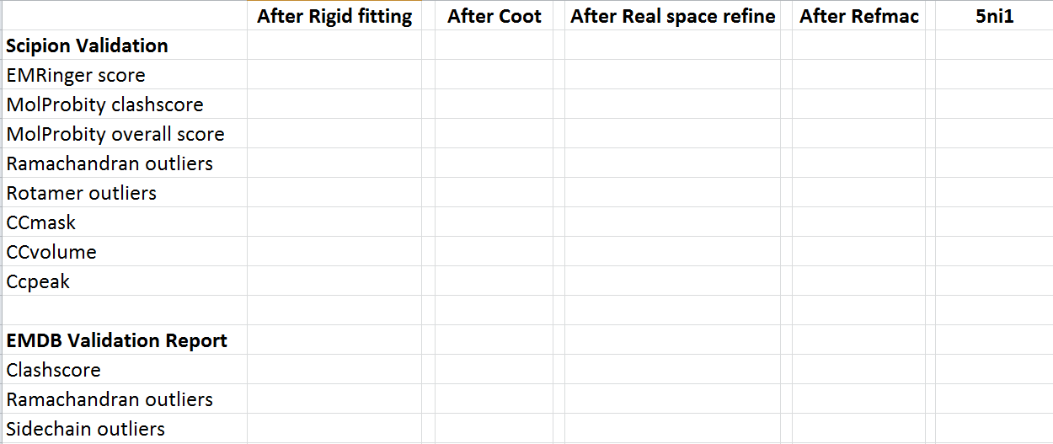
4.24
3.53
1.48
0
0.43 %
0.842
0.802
0.728
3
0
0.4 %

Slide 25
4.24
3.53
1.48
0
0.43 %
0.842
0.802
0.728
3
0
0.4 %

Slide 26
4.24
3.53
1.48
0
0.43 %
0.842
0.802
0.728
3
0
0.4 %

Slide 27
4.24
3.53
1.48
0
0.43 %
0.842
0.802
0.728
3
0
0.4 %

Slide 29


Slide 30
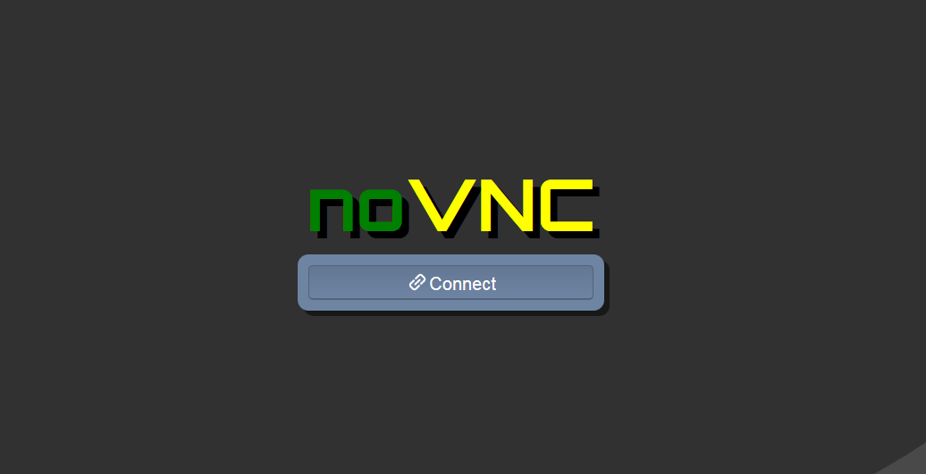
password: scipion4u

Slide 31
