Slide 1
ActivitySim University Model Enhancements
March 1, 2021
ActivitySim Technical Call

Slide 2
Today’s presentation
Motivation for enhancements
Limitations in current implementation
Enhancements
Status and next steps

Slide 3
Motivation

Slide 4
Motivation
Deployment of ActivitySim model for SEMCOG revealed problems in aggregate treatment of university travel for major universities
University of Michigan transit trips significantly under-estimated
Why?

Slide 5
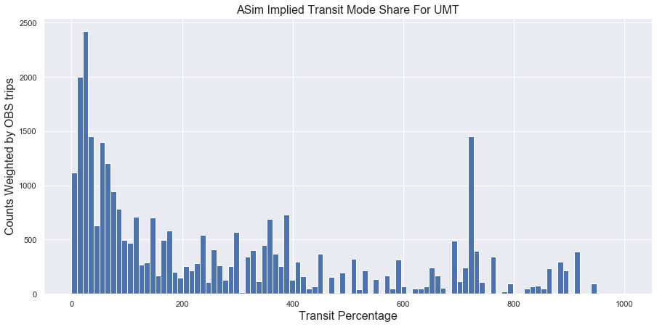
Model vs On-Board Survey
Origin TAZ | Destination TAZ | Total OBS Trips | Total ActivitySim Trips | Implied Transit Percentage
2152 | 2240 | 1449 | 201 | 721
2238 | 2152 | 1313 | 79 | 1662
2152 | 2238 | 1156 | 66 | 1751
2240 | 2152 | 728 | 189 | 385
2156 | 2240 | 723 | 39 | 1853
2157 | 2240 | 705 | 53 | 1331
… | … | … | … | …
Need more model demand around University of Michigan – are university students traveling enough?

Slide 6
Initial steps
Basic checks
  Group quarters housing properly accounted for, represented in synthetic population
  Enrollment properly coded
  Transit routes properly coded
  Reasonable spatial distribution of off-campus students
Some initial calibration
  Increase the percentage of university students with a mandatory tour (CDAP)
  Reduce auto ownership for on-campus students (asserted at 90% with 0 autos, 10% with 1 auto)
Improved somewhat but model still far short of on-board survey and route level ridership!

Slide 7
Current ActivitySim Limitations

Slide 8
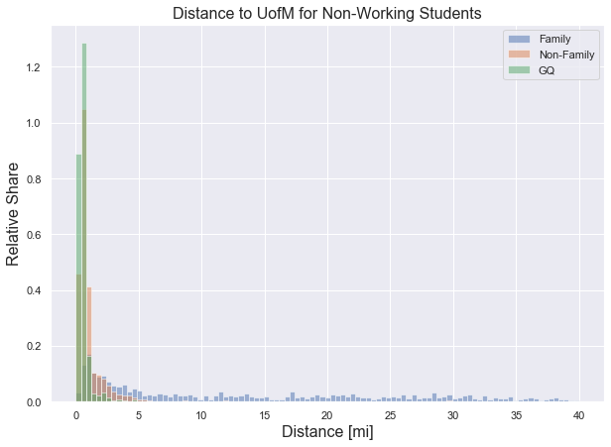
Problem #1: Distance to University Trips is Really Short!
Leads to a lot of walking trips – no need to take transit if you are just going to the adjacent TAZ!

Slide 9
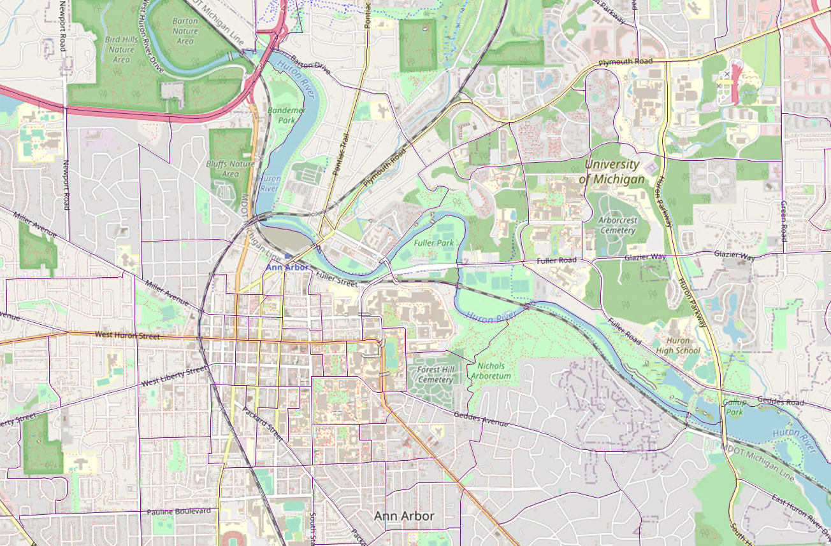
University Location Choice
University of Michigan campus is spread out. The model is heavily influenced by accessibility and tends to send a large portion of students to neighboring zones based on proximity and high enrollment. Actual class schedules don’t work that way.

Slide 10
Problem #2: University stop location, frequency and purpose
Location for university stops is always set to university location choice result
  Little inter-zonal intra-campus travel
University stop frequency rate may be low (checking)
Probability for university stops on university tours is low
primary_purpose | outbound | person_type | work | univ | school | escort | shopping | othmaint | eatout | social | othdiscr
univ | TRUE | PTYPE_FULL | 53% | 18% | 0% | 2% | 16% | 4% | 3% | 6% | 0%
univ | TRUE | PTYPE_PART | 6% | 94% | 0% | 0% | 0% | 0% | 0% | 0% | 0%
univ | TRUE | PTYPE_UNIVERSITY | 11% | 3% | 0% | 38% | 14% | 15% | 9% | 5% | 5%
univ | FALSE | PTYPE_FULL | 35% | 3% | 0% | 3% | 15% | 11% | 18% | 3% | 12%
univ | FALSE | PTYPE_PART | 0% | 0% | 0% | 82% | 18% | 0% | 0% | 0% | 0%
univ | FALSE | PTYPE_UNIVERSITY | 5% | 3% | 0% | 19% | 21% | 18% | 16% | 7% | 11%

Slide 11
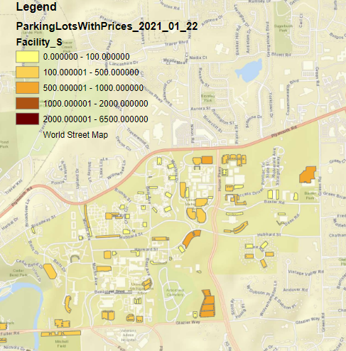
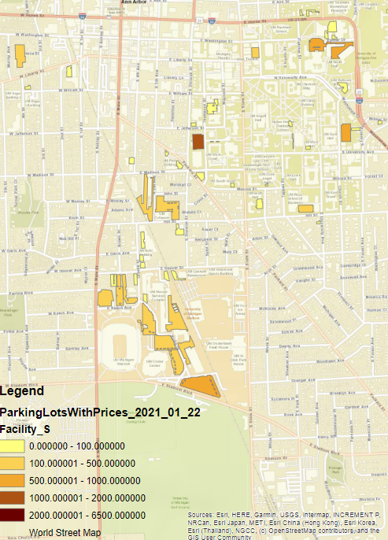
Problem #3: Auto tours to/from campus do not consider parking location choice
Limited parking, spread around campus
Permit controlled with cheaper parking located in satellite lots requiring long walks or transit access

Slide 12
Enhancements

Slide 13
Enhancements
Allow students attending ‘major’ universities to select multiple on-campus destinations
  Not always ‘usual school location’
  Not based on accessibility
Calibrate stop frequency and purpose distribution for ‘major university students’ to observed data
  University of Oregon student survey
Choose a parking location for auto tours from off-campus to campus zones
  And allow walk and transit on trips between lot and on-campus activity

Slide 14
How (1)
Added a ‘major university’ field to zonal data file to identify which zones belong to each major university
Run school location choice model. Identify students attending major university
Rechoose their destination zone based on size (enrollment)
  For university tour primary location
  For university purpose stops on university tours

Slide 15
How (2)
Identify auto tours to major university zones
Insert a stop for parking
  Before their first on-campus activity
  After their last on-campus activity
Choose parking location based on size (parking spaces)
  May need to add an accessibility term
  Currently no parking constraints
Model the trip between parking and on-campus activity as “walk-transit” tour rather than “auto” tour mode
  Has shared-ride, walk, walk-transit available
  Will require calibration

Slide 16


Current Model Structure
- initialize_landuse
- compute_accessibility
- initialize_households
- school_location
- workplace_location
- work_from_home
- auto_ownership_simulate
- free_parking
- telecommute_frequency
- cdap_simulate
- mandatory_tour_frequency
- mandatory_tour_scheduling
- joint_tour_frequency
- joint_tour_composition
- joint_tour_participation
- joint_tour_destination
- joint_tour_scheduling
- non_mandatory_tour_frequency
- non_mandatory_tour_destination
- non_mandatory_tour_scheduling
- tour_mode_choice_simulate
- atwork_subtour_frequency
- atwork_subtour_destination
- atwork_subtour_scheduling
- atwork_subtour_mode_choice
- stop_frequency
- trip_purpose
- trip_destination
- trip_purpose_and_destination
- trip_scheduling
- trip_mode_choice
- write_data_dictionary
- track_skim_usage
- write_trip_matrices
- write_tables
Enhancements
university_location_zone_override
Apply only to university students attending specified large university
Remove accessibility terms
Output: override school_taz field
= Modify Spec
= New Model Development
trip_destination_univ_zone_override
Re-samples univ destination according to university enrollment
Remove accessibility terms
Output: override trip_destination_taz field
parking_location_choice_at_university
Apply only to tours with at least one activity at specified large university zones with auto tour mode
Hopefully would be able to just use ARC code and just modify spec
Output: add column to tour table called parking_taz_on_campus
stop_frequency_parking_override
Adds parking trips / stops at start and end of trips at university zones
Group consecutive stops on university zones together
Output: 2 additional parking trip records in trip table
trip_mode_choice
Revise mode utilities as if walk-transit tour mode for trips between parking activities
Output: trip_mode_choice

Slide 17
Status and Next steps

Slide 18
Status and Next Steps
Enhancements are implemented and tested
Calibration over next 2-3 weeks
  Will require careful comparisons to on-board survey
Modifications to ActivitySim required before enhancements are pulled from SEMCOG
  Sampling procedure needs to be tied to hh_id. Requires a new function in ActivitySim’s random number generation code.
  Fix required to ensure that inserting new trips does not break the random number seeds of other trips.

Slide 19
Joel Freedman
Senior Director
Joel.freedman@rsginc.com

